Slide 1

Management Information Systems: Managing the Digital Firm
Seventeenth Edition, Global Edition
Chapter 9
Achieving Operational Excellence and Customer Intimacy: Enterprise Applications
Copyright © 2022, 2020, 2018 Pearson Education, Ltd. All Rights Reserved
Notes:
If this PowerPoint presentation contains mathematical equations, you may need to check that your computer has the following installed:
1) MathType Plugin
2) Math Player (free versions available)
3) NVDA Reader (free versions available)

Slide 2
Learning Objectives
9.1 How do enterprise systems help businesses achieve operational excellence?
9.2 How do supply chain management systems coordinate planning, production, and logistics with suppliers?
9.3 How do customer relationship management systems help firms achieve customer intimacy?
9.4 What are the challenges that enterprise applications pose, and how are enterprise applications taking advantage of new technologies?
9.5 How will M I S help my career?
Notes:
This chapter looks at enterprise applications, which collect and integrate data from many different departments and systems throughout the business. Ask students to review what operational excellence is. What is customer intimacy and why does this help the business? Have they ever heard of “supply chains” before?

Slide 3
Video Cases
Case 1: Maersk Develops a Global Shipping Management System

Slide 4
Lenzing Sustainably Balances Supply and Demand (1 of 2)
Problem
  High environmental standards
  Global operations
  Inefficient supply chain
  Manual processes
Solutions
  Establish sustainability goals
  Promote innovation
  Select new technology
  Revise supply chain processes
  Deploy J D A Sales & Operations Planning

Slide 5
Lenzing Sustainably Balances Supply and Demand (2 of 2)
Lenzing implemented J D A’s Sales & Operations Planning software to gain better visibility into its supply chain, leading to greater forecast accuracy, better decisions, and higher operational efficiency across the global enterprise
Helped Lenzing minimize waste and made its entire supply chain “leaner”
Illustrates the critical nature of supply chain management systems in business

Slide 6
What Are Enterprise Systems
Also known as enterprise resource planning (ERP) systems
Based on a suite of integrated software modules and a common central database
Collects data from many divisions of firm for use in nearly all of firm’s internal business activities
Information entered in one process is immediately available for other processes
Notes:
This slide describes the main purpose of enterprise systems. Ask students for examples of why it might be valuable to have information from one process instantly available to another process.
.

Slide 7
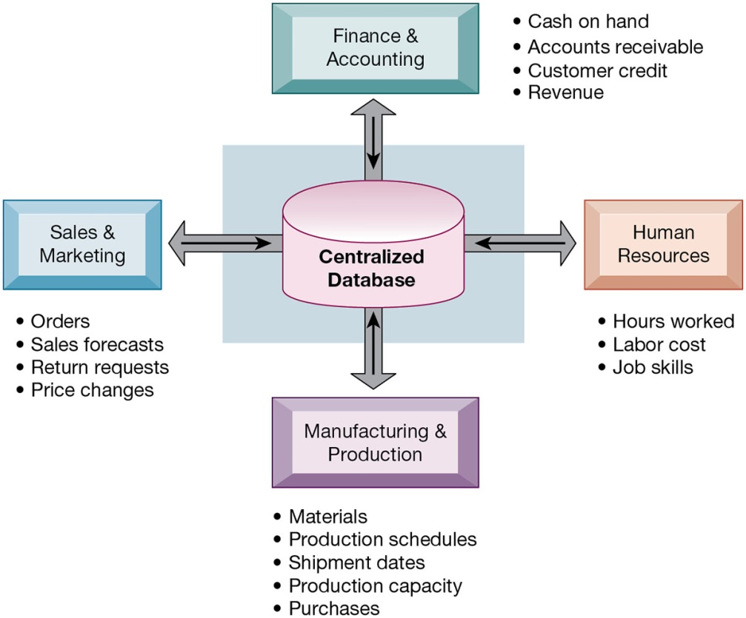
Figure 9.1 How Enterprise Systems Work
Notes:
Figure 9.1, Page 340.
Enterprise systems feature a set of integrated software modules and a central database by which business processes and functional areas throughout the enterprise can share data.
This graphic illustrates the function of enterprise software to integrate and share data between the different business functions. One of the key ideas of enterprise solutions is that there’s “one company, one database” and not a collection of disconnected databases.
Alt Text
Long description: A radial diagram explains how enterprise systems work. The details of the diagram are as below:
At the center of the radial diagram is the central database which is connected to various business processes and functional areas in an enterprise.
The various business processes and functional areas are as follows:
Finance and Accounting: Cash on hand; Accounts receivable; Customer credit; Revenue.
Human Resources: Hours worked; Labor cost; Job skills.
Manufacturing and Production: Materials; Production schedules; Shipment dates; Production capacity; Purchases.
Sales and Marketing: Orders; Sales forecasts; Return requests; Price changes.

Slide 8
Enterprise Software
Built around thousands of predefined business processes that reflect best practices
  Finance and accounting
  Human resources
  Manufacturing and production
  Sales and marketing
To implement, firms:
  Select functions of system they wish to use
  Map business processes to software processes
    Use software’s configuration tables for customizing
Notes:
This slide describes the functions in an enterprise software package and how it would be implemented by a firm. Ask students why it is typically best to perform only minimal changes to enterprise software, and instead, change the way the firm works in order to conform to the software’s business processes.

Slide 9
Business Value of Enterprise Systems
Increase operational efficiency
Provide firm-wide information to support decision making
Enable rapid responses to customer requests for information or products
Include analytical tools to evaluate overall organizational performance and improve decision-making
Notes:
This slide discusses the business values of enterprise systems. What does it mean for the firm that enterprise systems enforce the use of common standardized definitions and formats for data by the entire organization?
The text cites the example of Alcoa, which implemented enterprise software to eliminate redundant processes and systems, reduce requisition-pay-to-cycle time, reduce 20 percent of worldwide costs. This illustrates the tremendous value that an effective implementation of enterprise software can have.

Slide 10
The Supply Chain
Network of organizations and processes for:
  Procuring materials
  Transforming materials into products
  Distributing the products
Upstream supply chain
Downstream supply chain
Internal supply chain
Notes:
This slide introduces the concept of the supply chain. Supply chain management software is a type of enterprise software for managing complicated supply chains that may include thousands of suppliers.
The text gives the example of Nike’s sneakers’ supply chain. What types of firms are in the upstream supply chain? In the downstream supply chain?

Slide 11
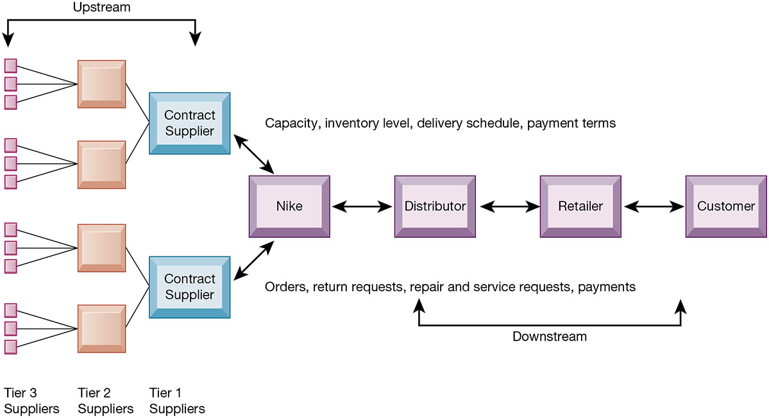
Figure 9.2 Nike’s Supply Chain
Notes:
Figure 9.2, Page 343.
This figure illustrates the major entities in Nike’s supply chain and the flow of information upstream and downstream to coordinate the activities involved in buying, making, and moving a product. Shown here is a simplified supply chain, with the upstream portion focusing only on the suppliers for sneakers and sneaker soles.
This graphic illustrates the major entities in Nike’s supply chain. Ask students what the difference is between tier 1, 2, and 3 suppliers.
Alt Text
Long description: A process diagram illustrates Nike’s supply chain and the flow of information. The process diagram is divided into two sections: Upstream and downstream.
Several tier three supplies connect to suppliers in tier two who in turn connect to the contract suppliers in tier one. This process of the flow diagram is labeled upstream.
From the contract suppliers a two-way path is depicted to illustrate the downstream process.
The first flow is illustrated as follows: Nike; Distributor; Retailer; Customer. The capacity, inventory level, delivery schedule, and payment terms are handled here.
The second flow is illustrated as follows: Customer; Retailer; Distributor; Nike. The orders, return requests, repair and services, and payments are handled here.

Slide 12
Supply Chain Management
Inefficiencies cut into a company’s operating costs
  Can waste up to 25 percent of operating expenses
Just-in-time strategy
  Components arrive as they are needed
  Finished goods shipped after leaving assembly line
Safety stock: buffer for lack of flexibility in supply chain
Bullwhip effect
  Information about product demand gets distorted as it passes from one entity to next across supply chain
Notes:
This slide discusses the effects of timely and untimely information on a supply chain. Ask students what causes inefficiencies in a supply chain (parts shortages, underutilized plant capacity, excessive finished goods inventory, high transportation costs). These are caused by untimely information. Perfect information can result in a just-in-time strategy.
Because of uncertainties, manufacturers keep a safety stock. Why is this an inefficient result? Another effect of uncertainties is the bullwhip effect.

Slide 13
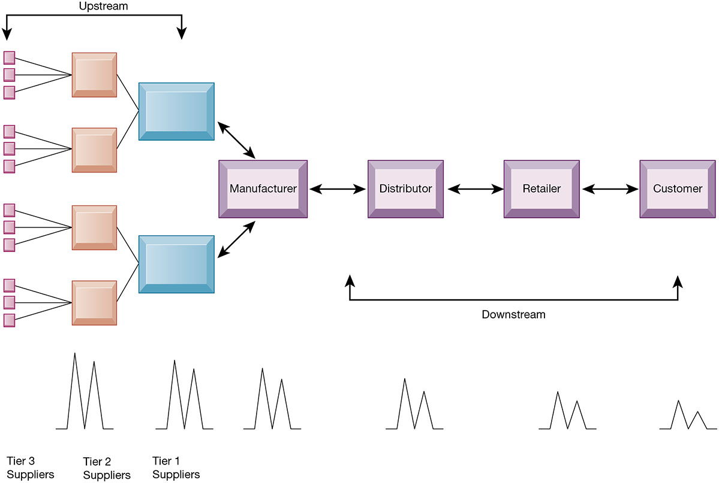
Figure 9.3 The Bullwhip Effect
Notes:
Figure 9.3, Page 345.
Inaccurate information can cause minor fluctuations in demand for a product to be amplified as one moves further back in the supply chain. Minor fluctuations in retail sales for a product can create excess inventory for distributors, manufacturers, and suppliers.
This graphic illustrates how a slight rise in demand by customers for an item will cause successive participants to slightly overstock related inventory “just in case.” These changes are amplified as one moves back further in the system.
Alt Text
Long description: A process diagram illustrates the bullwhip effect using a sample supply chain. The process diagram is divided into two sections: Upstream and downstream.
Several tier three supplies connect to suppliers in tier two who in turn connect to the contract suppliers in tier one. This process of the flow diagram is labeled upstream.
From the contract suppliers a two-way path is depicted to illustrate the downstream process.
The first flow is illustrated as follows: Manufacturer; Distributor; Retailer; Customer.
The second flow is illustrated as follows: Customer; Retailer; Distributor; Manufacturer.
Descending intensity of fluctuations is represented by spike waves icons in decreasing order of size, from tier three supplier to customer.

Slide 14
Supply Chain Management Software
Supply chain planning systems
  Model existing supply chain
  Enable demand planning
  Optimize sourcing, manufacturing plans
  Establish inventory levels
  Identify transportation modes
Supply chain execution systems
  Manage flow of products through distribution centers and warehouses
Notes:
This slide discusses the two main types of supply chain management systems. Ask students to explain and describe the concept of “demand planning.” It determines how much product a business needs to make to satisfy customer demand.

Slide 15
Global Supply Chains and the Internet
Global supply chain issues
  Greater geographical distances, time differences
  Participants from different countries
    Different performance standards
    Different legal requirements
Internet helps manage global complexities
  Warehouse management
  Transportation management
  Logistics
  Outsourcing
Notes:
This slide discusses the additional complexities experienced by global supply chains. Today’s apparel industry relies heavily on outsourcing to contract manufacturers in China and other low-wage countries. Apparel companies use the web extensively to manage their global supply chain and production issues.

Slide 16
Demand-Driven Supply Chains: From Push to Pull Manufacturing and Efficient Customer Response
Push-based model (build-to-stock)
  Earlier S C M systems
  Schedules based on best guesses of demand
Pull-based model (demand-driven)
  Web-based
  Customer orders trigger events in supply chain
Internet enables move from sequential supply chains to concurrent supply chains
  Complex networks of suppliers can adjust immediately
Notes:
This slide discusses the fact that SCM systems facilitate efficient customer response, allowing the workings of the business to be driven more by customer demand, moving from push-based, sequential models to pull-based, concurrent models of production. Ask students for examples from the text of the pull-based model (Walmart, Dell).

Slide 17
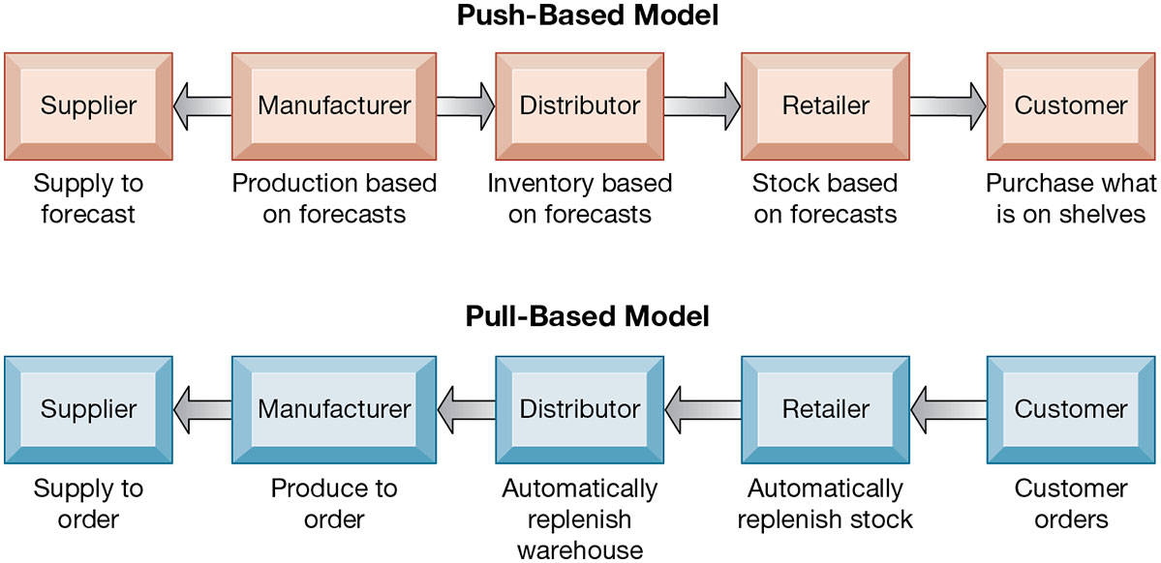
Figure 9.4 Push- Versus Pull-Based Supply Chain Models
Notes:
Figure 9.4, Page 347.
The difference between push- and pull-based models is summarized by the slogan “Make what we sell, not sell what we make.”
This graphic illustrates the difference between the earlier, push-based model of supply chains to the pull-based model. Ask students if there are some industries uniquely suited to the pull-based model. How about automobiles, appliances, and consumer durables? What are the drawbacks of a pull-based model?
Alt Text
Long description: Two linear flow diagrams explain the difference between push- and pull-based supply chain models. The details are as below:
Push-based model:
Manufacturer is connected to both supplier and distributer. The distributer is further connected to the retailer, who in turn is connected to the customer.
In this model, manufacturer produces based on forecasts and supplies it based on the same to the supplier. The distributor has the inventory based on the forecasts and the retailer stocks based on the forecasts. The customer purchases what is on the shelves.
The connections in the pull-based model are as follows:
Customer
Retailer
Distributor
Manufacturer
Supplier
In this model, the customer orders and the retailer automatically replenishes the stock. The distributor also automatically replenishes the warehouse. The manufacturers produce to order and the supplier supplies to order.

Slide 18
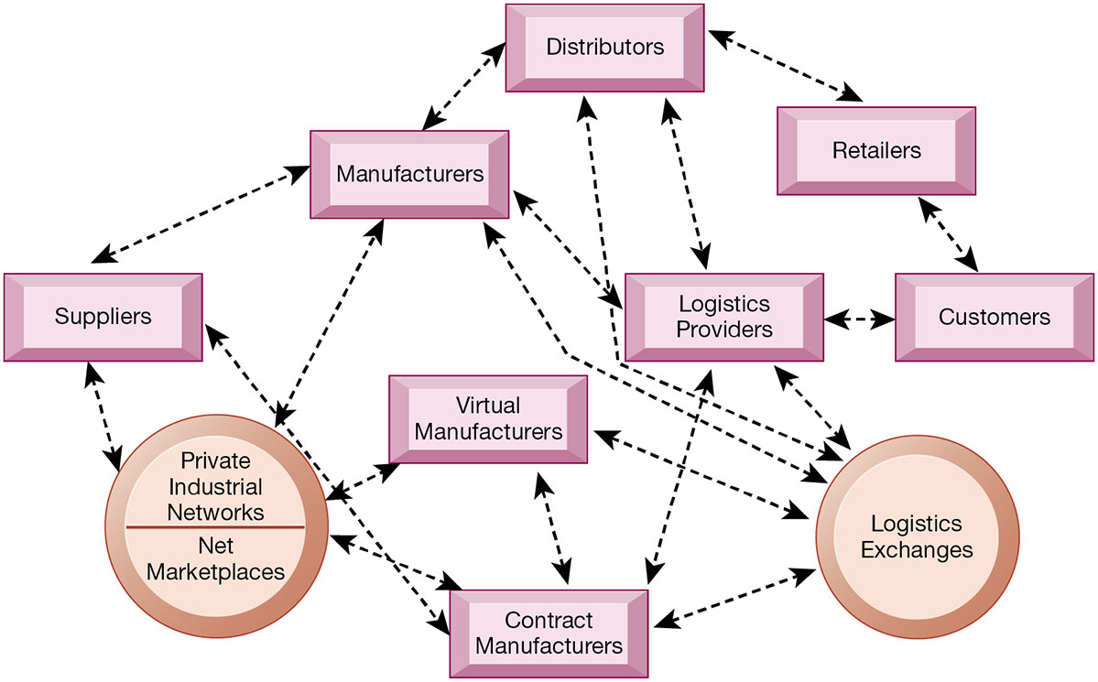
Figure 9.5 The Emerging Internet-Driven Supply Chain
Notes:
Figure 9.5, Page 348.
The emerging Internet-driven supply chain operates like a digital logistics nervous system. It provides multidirectional communication among firms, networks of firms, and e-marketplaces so that entire networks of supply chain partners can immediately adjust inventories, orders, and capacities.
This graphic illustrates the multidirectional communications within a future supply chain driven by the Internet. Private industrial networks and Net marketplaces are discussed in Chapter 10. Private industrial networks are typically a large firm using an extranet to link to its suppliers and other key business partners. Net marketplaces are digital marketplaces based on Internet technology for many different buyers and sellers.
Alt Text
Long description: An illustration explains the Internet-driven supply chain. The details are as below:
The private industrial networks and the net marketplaces are connected to the suppliers, virtual manufacturers, and contract manufacturers.
The contract manufacturers are connected to the virtual manufacturers, logistics exchanges, and logistics providers.
The virtual manufacturers are connected to the logistics exchanges.
Suppliers are connected to the manufacturers.
Manufacturers are connected to the private industrial networks and the net marketplaces, distributers, logistic providers, and the logistics exchanges.
Distributers are connected to the retailers, logistic providers, and the logistics exchanges.
Retailers are connected to the customers and the customers to the logistic providers. The logistic provider is connected to the logistics exchanges.
All the connections are depicted via bidirectional dashed arrows.

Slide 19
Business Value of Supply Chain Management Systems
Match supply to demand
Reduce inventory levels
Improve delivery service
Speed product time to market
Use assets more effectively
  Total supply chain costs can be 75 percent of operating budget
Increase sales
Notes:
This slide examines the value of using SCM systems to businesses. Ask students how increased sales can result from a more efficient supply chain.

Slide 20
Customer Relationship Management
Knowing the customer
In large businesses, too many customers and too many ways customers interact with firm
C R M systems
  Capture and integrate customer data from all over the organization
  Consolidate and analyze customer data
  Distribute customer information to various systems and customer touch points across enterprise
  Provide single enterprise view of customers
Notes:
This slide introduces the concept of customer relationship management as a key function of the business and the use of CRM systems to provide a single place to consolidate and analyze data about the customer.
Ask students to provide examples of the different types of customer data that would be captured by a firm. What types of valuable information does the firm need to know about its customers (most profitable, loyal customers). Have students directly interacted with a CRM? They probably do not know it, but anytime they call into a call center for help they are dealing with some kind of CRM that tracks some or all of their interactions with a firm.

Slide 21
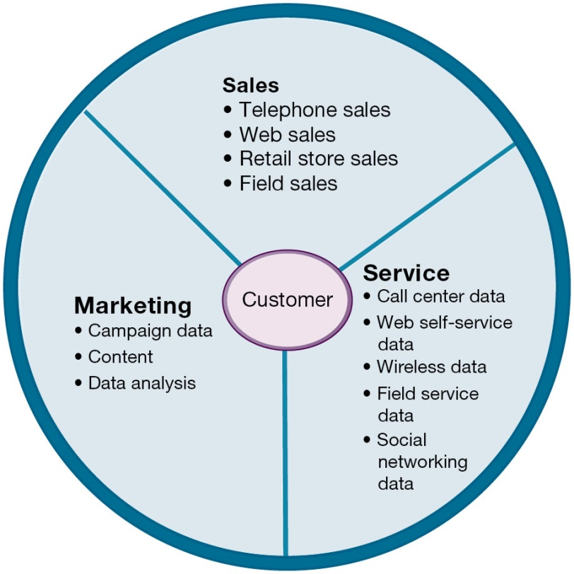
Figure 9.6 Customer Relationship Management (C R M)
Notes:
Figure 9.6, Page 350.
CRM systems examine customers from a multifaceted perspective. These systems use a set of integrated applications to address all aspects of the customer relationship, including customer service, sales, and marketing.
This graphic illustrates the functions found in the integrated applications of a CRM system.
Alt Text
Long description: A segmented circle explains the concept of customer relationship management. The circle is divided into three parts with an ellipse representing the customer at the center of the circle. Each of the parts belong to sales, marketing, and service respectively. The details are as below:
Sales: Telephone sales; Web sales; Retail store sales; Field sales.
Marketing: Campaign data; Content; Data analysis.
Service: Call center data; Web self-service data; Wireless data; Field service data; Social networking data.

Slide 22
Customer Relationship Management Software (1 of 2)
Packages range from niche tools to large-scale enterprise applications
More comprehensive packages have modules for:
  Partner relationship management (P R M)
    Integrating lead generation, pricing, promotions, order configurations, and availability
    Tools to assess partners’ performances
  Employee relationship management (E R M)
    Setting objectives, employee performance management, performance-based compensation, employee training
Notes:
This slide discusses the types of CRM software available, which range from niche tools to full-scale enterprise-wide applications. Ask students for examples of PRM functions (integrating lead generation, pricing, promotions, order configurations, and availability, tools to assess partners’ performances) and ERM functions (setting objectives, employee performance management, performance-based compensation, employee training).

Slide 23
Customer Relationship Management Software (2 of 2)
C R M packages typically include tools for:
  Sales force automation (S F A)
    Sales prospect and contact information
    Sales quote generation capabilities
  Customer service
    Assigning and managing customer service requests
    Web-based self-service capabilities
  Marketing
    Capturing prospect and customer data, scheduling and tracking direct-marketing mailings or e-mail
    Cross-selling

Slide 24
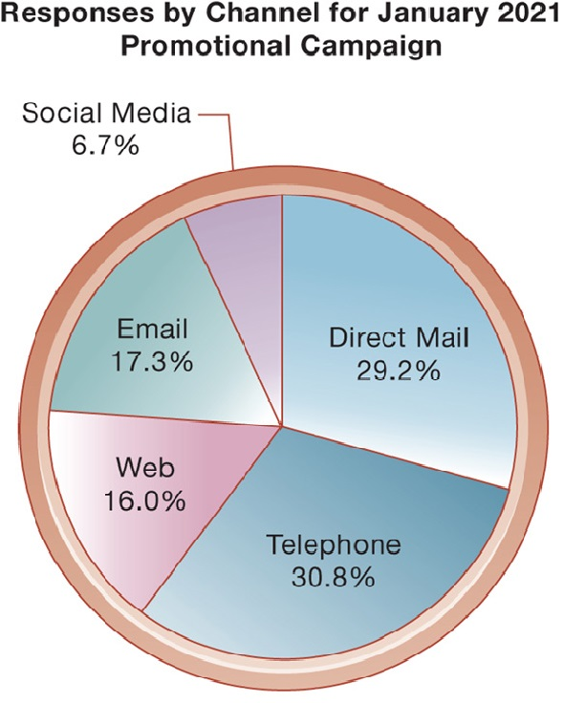
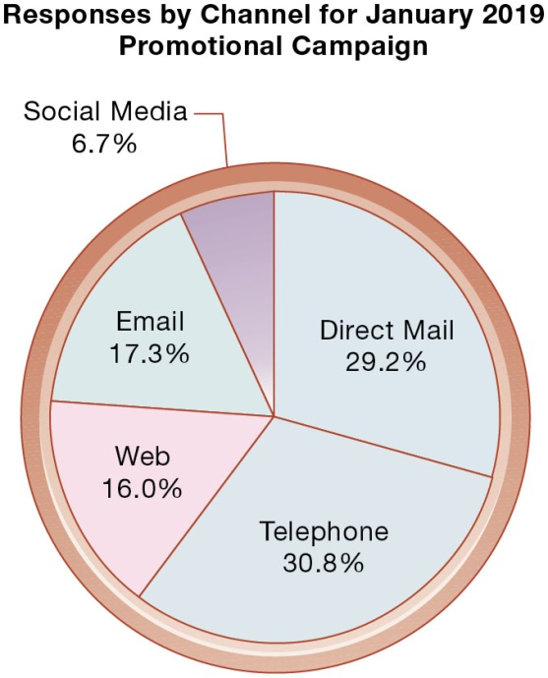
Figure 9.7 How C R M Systems Support Marketing
Notes:
Figure 9.7, Page 352.
Customer relationship management software provides a single point for users to manage and evaluate marketing campaigns across multiple channels, including e-mail, direct mail, telephone, the Web, and social media.
This graphic gives an example of how CRM systems can support marketing by analyzing and evaluating marketing campaigns.
Alt Text
Long description: A pie chart presents data on how customer relationship management systems support marketing. The details of the pie chart are as below:
Direct mail: 29.2%
Telephone: 30.8%
Web: 16.0%
Email: 17.3%
Social media: 6.7%
Text above the pie chart reads: Responses by channel for January 2021 promotional campaign.

Slide 25
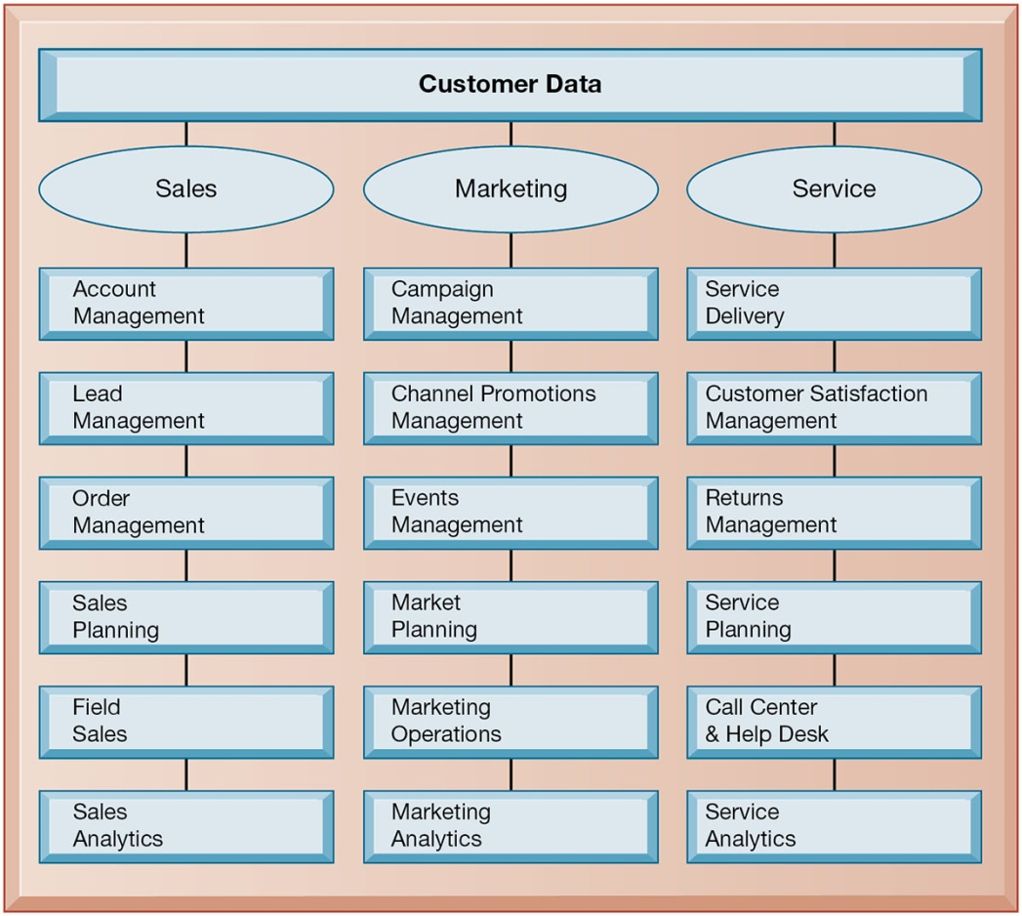
Figure 9.8 C R M Software Capabilities
Notes:
Figure 9.8, Page 352.
The major CRM software products support business processes in sales, service, and marketing, integrating customer information from many sources. Included is support for both the operational and analytical aspects of CRM.
This graphic illustrates the range of functions included in the sales, marketing, and service modules in a CRM package. As noted in the text, CRM software is business-process driven, incorporating hundreds of business processes thought to represent best practices in each of these areas. To achieve maximum benefit, companies need to revise and model their business processes to conform to the best-practice business processes in the CRM software.
Alt Text
Long description: An illustration explains how CRM software products support business processes in sales, service, and marketing. The details are as below:
Customer data from various sources is integrated and divided into sales, service, and marketing.
Under sales the CRM software products support the following: Account management; Lead management; Order management; Sales planning; Field sales; Sales analytics.
Under marketing the CRM software products support the following: Campaign management; Channel promotions management; Events management; Market planning; Marketing operations; Marketing analytics.
Under services the CRM software products support the following: Service delivery; Customer satisfaction management; Returns management; Service planning; Call center and help desk; Service analytics.

Slide 26
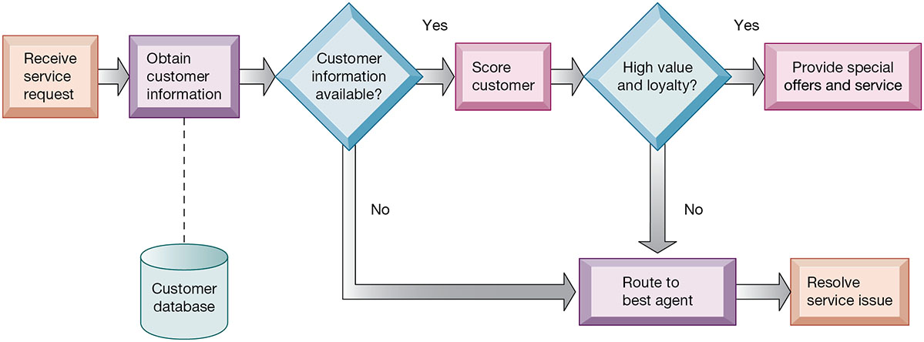
Figure 9.9 Customer Loyalty Management Process Map
Notes:
Figure 9.9, Page 353.
This process map shows how a best practice for promoting customer loyalty through customer service would be modeled by customer relationship management software. The CRM software helps firms identify high-value customers for preferential treatment.
This graphic illustrates how a best practice for increasing customer loyalty through customer service might be modeled by CRM software. What kinds of information might indicate that a customer is loyal or high value?
Alt Text
Long description: A flowchart explains how CRM software helps firms identify loyal customers for privileged treatment. The details are as below:
Receive service request.
Obtain customer information from the customer database.
Customer information available?
If yes: Score customer; Check if the customer is high-value and loyal. If yes: Provide special offers and service.
If no: Route to best agent and resolve issue.

Slide 27
Operational and Analytical C R M
Operational C R M
  Customer-facing applications
  Sales force automation call center and customer service support
  Marketing automation
Analytical C R M
  Based on data warehouses populated by operational C R M systems and customer touch points
  Analyzes customer data (O L A P, data mining, etc.)
    Customer lifetime value (C L T V)
Notes:
This slide discusses the two main types of CRM software—operational and analytical. Ask students how the CLTV is calculated (it is based on the relationship between the revenue produced by a specific customer, the expenses incurred in acquiring and servicing that customer, and the expected life of the relationship between the customer and the company.)

Slide 28
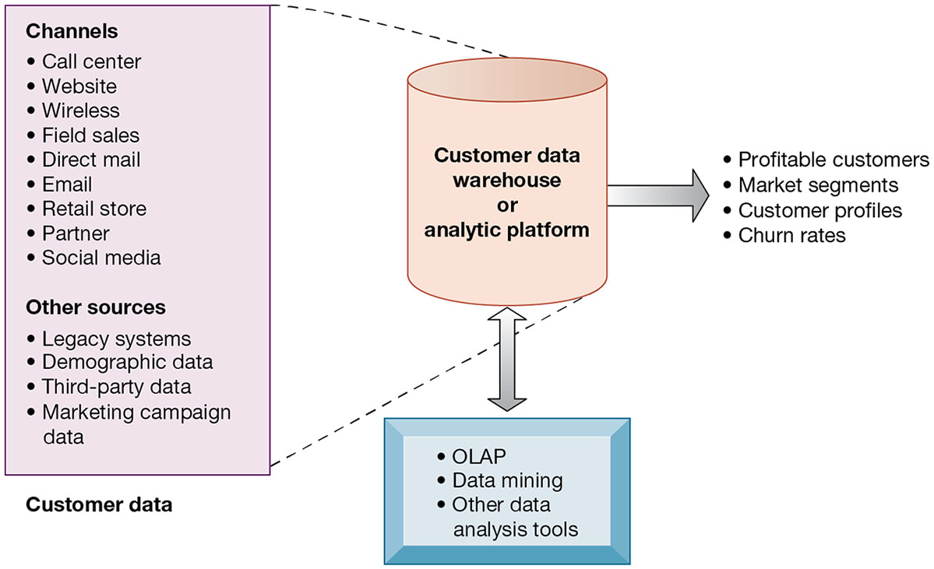
Figure 9.10 Analytical C R M Data Warehouse
Notes:
Figure 9.10, Page 354.
Analytical CRM uses a customer data warehouse or analytic platform and tools to analyze customer data collected from the firm’s customer touch points and from other sources.
This graphic illustrates the main components of analytical CRM. Data is captured from various channels and fed into a customer data warehouse or analytic platform, where OLAP, data mining, and other analysis tools help identify profitable customers, churn rates, and so on.
Alt Text
Long description: An illustration explains how analytical CRM uses customer data from various sources to create segments for targeted marketing. At the center of the illustration is the customer data warehouse or the analytic platform which is connected to the channels for procuring customer data and data analysis tools for obtaining the following results: Profitable customers, market segments, customer profiles, and churn rates.
Customer data is obtained from the below sources:
Under the channels are the following: Call center; Website; Wireless; Field sales; Direct mail; Email; Retail store; Partner; Social media.
Under other sources are: Legacy systems; Demographic data; Third-party data; Marketing campaign data.
Data analysis tools include the following: OLAP; Data mining; other data analysis tools.

Slide 29
Business Value of Customer Relationship Management Systems
Business value of C R M systems
  Increased customer satisfaction
  Reduced direct-marketing costs
  More effective marketing
  Lower costs for customer acquisition/retention
  Increased sales revenue
Churn rate
  Number of customers who stop using or purchasing products or services from a company
  Indicator of growth or decline of firm’s customer base
Notes:
This slide discusses the value to businesses of implementing a CRM system. How would marketing be made more effective by using a CRM system?

Slide 30
Interactive Session: Organizations: CRM Helps Adidas Know Its Customers One Shoe Buyer at a Time (1 of 2)
Class discussion
  Analyze Adidas using the competitive forces and value chain model.
  What is Adidas’s business strategy? What is the rule of customer relationship management in that strategy?
  How do information systems support Adidas’s strategy?

Slide 31
Interactive Session: Organizations: CRM Helps Adidas Know Its Customers One Shoe Buyer at a Time (2 of 2)
Class discussion
  How did using Salesforce.com make Adidas more competitive? How did it change the way the company ran its business?
  Give an example of two business decisions that were improved by using Salesforce.com

Slide 32
Enterprise Application Challenges
Expensive to purchase and implement
  Many projects experience cost overruns
  Long development times
Technology changes
Business process changes
Organizational learning changes
Switching costs, dependence on software vendors
Data standardization, management, cleansing
Notes:
This slide looks at the challenges firms face when they implement enterprise applications. Ask students to explain and apply with examples the concept of “switching costs.” What problems could result from being dependent on a single software vendor?

Slide 33
Next-Generation Enterprise Applications (1 of 2)
Enterprise solutions/suites
  Make applications more flexible, web-enabled, integrated with other systems
Cloud-based versions
Functionality for mobile platform
Versions also available for small and medium-sized businesses
Notes:
This slide looks at the trends in enterprise software. Leading vendors include SAP, Oracle, Microsoft, and Netsuite.

Slide 34
Next-Generation Enterprise Applications (2 of 2)
Social C R M
  Incorporating social networking technologies
  Company social networks
  Monitor social media activity; social media analytics
  Manage social and web-based campaigns
Business intelligence
  Inclusion of B I with enterprise applications
  Flexible reporting, ad hoc analysis, “what-if” scenarios, digital dashboards, data visualization, AI machine learning

Slide 35
Interactive Session: Technology: Versum’s ERP Transformation
Class discussion
  Define the problem in this case study. What management, organization, and technology factors contributed to this problem?
  Was the SAP S/4 HANA SaaS solution a good one for Versum? Explain your answer.
  What challenges did Versum encounter implementing the new system?
  How did the new system change the way Versum ran its business?

Slide 36
How Will M I S Help My Career?
The Company: X Y Z Global Industrial Components
Position Description: Manufacturing management trainee
Job Requirements
Interview Questions
Author Tips
Notes:
A good opportunity for a class discussion of the section on careers. Would any in the class be interested in a job like this? What do they think are the most important skills the employer is looking for? How would they answer the interviewer questions?

Slide 37

Copyright
This work is protected by United States copyright laws and is provided solely for the use of instructors in teaching their courses and assessing student learning. Dissemination or sale of any part of this work (including on the World Wide Web) will destroy the integrity of the work and is not permitted. The work and materials from it should never be made available to students except by instructors using the accompanying text in their classes. All recipients of this work are expected to abide by these restrictions and to honor the intended pedagogical purposes and the needs of other instructors who rely on these materials.

